Slide 1
Web Development
By Uchenna Nnamani

Slide 2
Why Web?
Responsive Design and Progressive Web Apps (PWAs)
Content Management Systems (CMS)
E-commerce Platforms
Search Engine Optimization (SEO) Strategies
Cloud-based Web Hosting Solutions
Notes:
Responsive Design and Progressive Web Apps (PWAs): Discuss the importance of responsive web design and how it enhances user experience across different devices. Explore the concept of PWAs, which combine the best of web and mobile app experiences.
Content Management Systems (CMS): Explain the role of CMS platforms in website development. Compare popular CMS options (such as WordPress, Joomla, or Drupal) and guide your audience on choosing the right one for their needs.
E-commerce Platforms: Dive into the world of e-commerce development. Cover topics like setting up online stores, integrating payment gateways, managing inventory, and ensuring a seamless shopping experience.
Search Engine Optimization (SEO) Strategies: Highlight effective SEO techniques to improve web visibility. Discuss keyword research, on-page optimization, backlink building, and the impact of SEO on organic traffic.
Cloud-based Web Hosting Solutions: Compare different cloud hosting providers (such as AWS, Google Cloud, or Microsoft Azure). Explain the benefits of cloud hosting, scalability, security, and best practices for deployment.

Slide 3



the web Language – Front End
Main:
- Hypertext Markup Language
- CSS
- JavaScript

Slide 4

Hyper Text Markup Language
HTML stands for HyperText Markup Language and it is the standard language for creating web pages and web applications HTML it is a “formatting” language not a programming language.
HTML was invented by Tim Berners-Lee in 1989
HTML is based on the concept of hypertext, which is a way of presenting information that allows users to navigate through different topics by clicking on links
Notes:
HTML History
HTML stands for HyperText Markup Language and it is the standard language for creating web pages and web applications. HTML was invented by Tim Berners-Lee in 1989, when he was working at CERN, the European Organization for Nuclear Research. Berners-Lee's goal was to create a simple markup language that could link different documents together, forming a web of interconnected information. In other words, He wanted to create a system that would allow researchers to share and link documents across different computers and networks.
HTML Concept
HTML is based on the concept of hypertext, which is a way of presenting information that allows users to navigate through different topics by clicking on links. HTML uses tags, which are special keywords enclosed in angle brackets (< and >), to define the structure and content of a web page. For example, the <p> tag indicates a paragraph, the <h1> tag indicates a heading level 1, and the <a> tag indicates a hyperlink.
HTML Future
HTML is still evolving and new features are being added or modified by various groups and organizations. The W3C maintains the official specification of HTML5 and its updates, while the Web Hypertext Application Technology Working Group (WHATWG) develops a living standard of HTML that reflects the current state of web browsers and technologies. HTML is also influenced by other languages and standards, such as CSS (Cascading Style Sheets), JavaScript, SVG (Scalable Vector Graphics), MathML (Mathematical Markup Language), etc.
HTML is the foundation of the web and it has changed the way we communicate, learn, work, and play. By learning HTML, you can create your own web pages and web applications that can reach millions of users around the world.

Slide 5
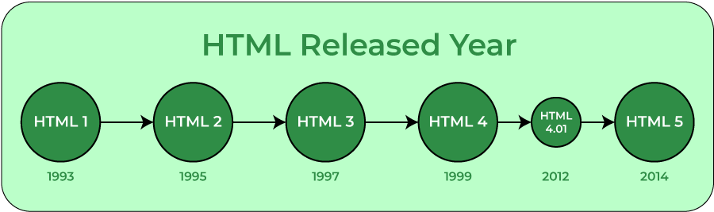
Evolution
Notes:
HTML Versions
HTML 1.0: - The first version of HTML was very simple and had only 18 tags. It was called HTML 1.0 and it was published as an Internet Engineering Task Force (IETF) document in 1993.
HTML 2.0: - tables, forms, images, and other elements.
HTML 3.2: - for style sheets, scripts, applets, and multimedia elements.
HTML 4.0: - frames, style sheets, scripts, and document structure. It also added support for internationalization, accessibility, and semantic markup.
HTML 4.01: - fixed some errors and inconsistencies in HTML 4.0.
XHTML 1.0: This version was published as a W3C recommendation in 2000 and it reformulated HTML 4.01 as an application of XML (Extensible Markup Language). XML is a more strict and powerful language than HTML and it allows users to define their own tags and attributes. XHTML 1.0 required web pages to follow the rules of XML syntax, such as closing all tags and using lowercase letters for tag names.
HTML5:
introduced new tags for semantic elements, such as <header>, <footer>, <article>, <section>, <nav>, etc.,
multimedia elements, such as <video>, <audio>, <canvas>
Support for offline storage, geolocation, drag-and-drop, web sockets, web workers, and other features that enable rich web applications.

Slide 6

CSS – cascading style sheet
CSS was created for web designers to change the layout, colors, and fonts of
their websites.
CSS was created Håkon Wium Lie to allow web designers to change the layout, colors, and fonts of their websites
Notes:
CSS was created Håkon Wium Lie to allow web designers to change the layout, colors, and fonts of their websites. Originally, websites were meant to be used by researchers only, so the decoration did not matter. However, when websites became widespread, the need to make them look nice grew
World Wide Web Consortium (W3C)

Slide 7
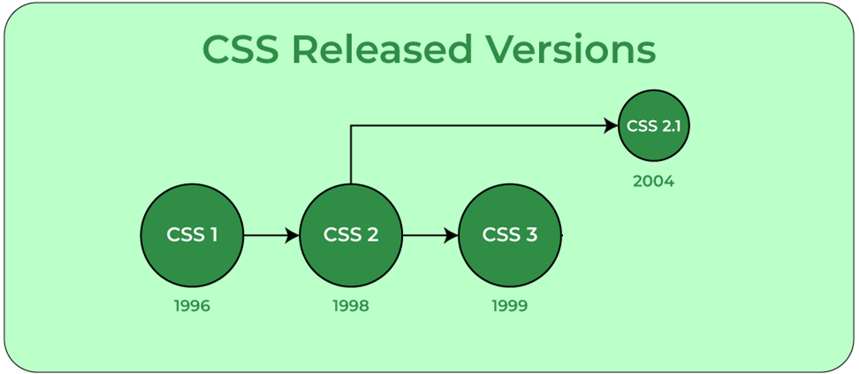
Evolution
Notes:
1994 - Håkon Wium Lie works at CERN , proposed the idea of CSS.
1996 - The first version of CSS was invented.
1998 - CSS 2 was released and work on CSS 3 began. All additions and enhancements to the specification were written in order to be backward-compatible with older versions of CSS.
2011- CSS 2.1 was released, which fixed the errors found in CSS 2
2005- CSS 3 was released which has support for responsive design – grid/flexbox, browser support, Backward compatibility with CSS2, advance animation text-animation, transformations and transitions, support media queries, css grouping or module, wild color schemes – RGBA,HSLA,HSL etc., Better performance speed, memory management

Slide 8
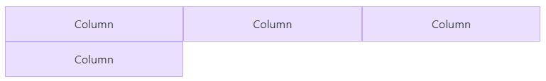
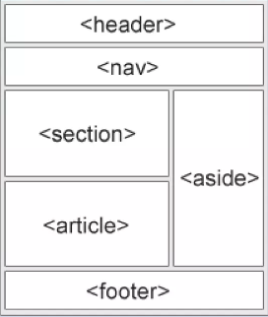
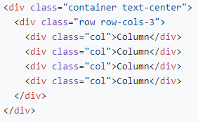
Layout
Table
Bootstrap
Grid
Flex

Slide 9


JavaScript
JavaScript is the programming language of the Internet or Web
JavaScript was created by Brendan Eich in 1995 during his time at Netscape Communications
The creators of JavaScript wanted to borrow concepts from other programming languages, such as Java and C
JavaScript is considered a ‘loosely’ typed language, in which types do exist, but they are not enforced

Slide 10
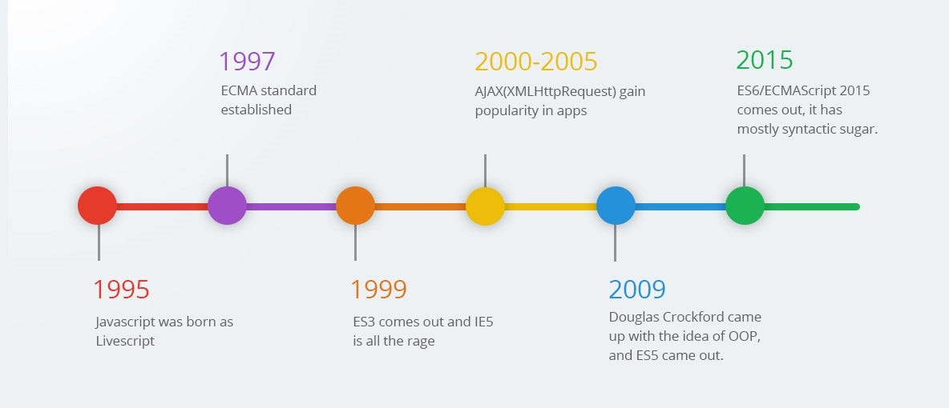
Evolution

Slide 11








Web Language Ecosystem
There are many IDEs, tools, Libraries and frameworks for web development
- IDEs - VS Code, Visual Studio, Rider, Eclipse etc.
- Packager and bundlers – Npm (node) , webpack, rollup, SWC
- Tools - Typescript , Linters, Prettier etc.
- Library - React, jQuery etc.
- Angular , Vue etc.
- UI/UX – Figma, Adobe XD …
Notes:
Swc - Speedy Web Compiler
Npm – Node package managers

Slide 12
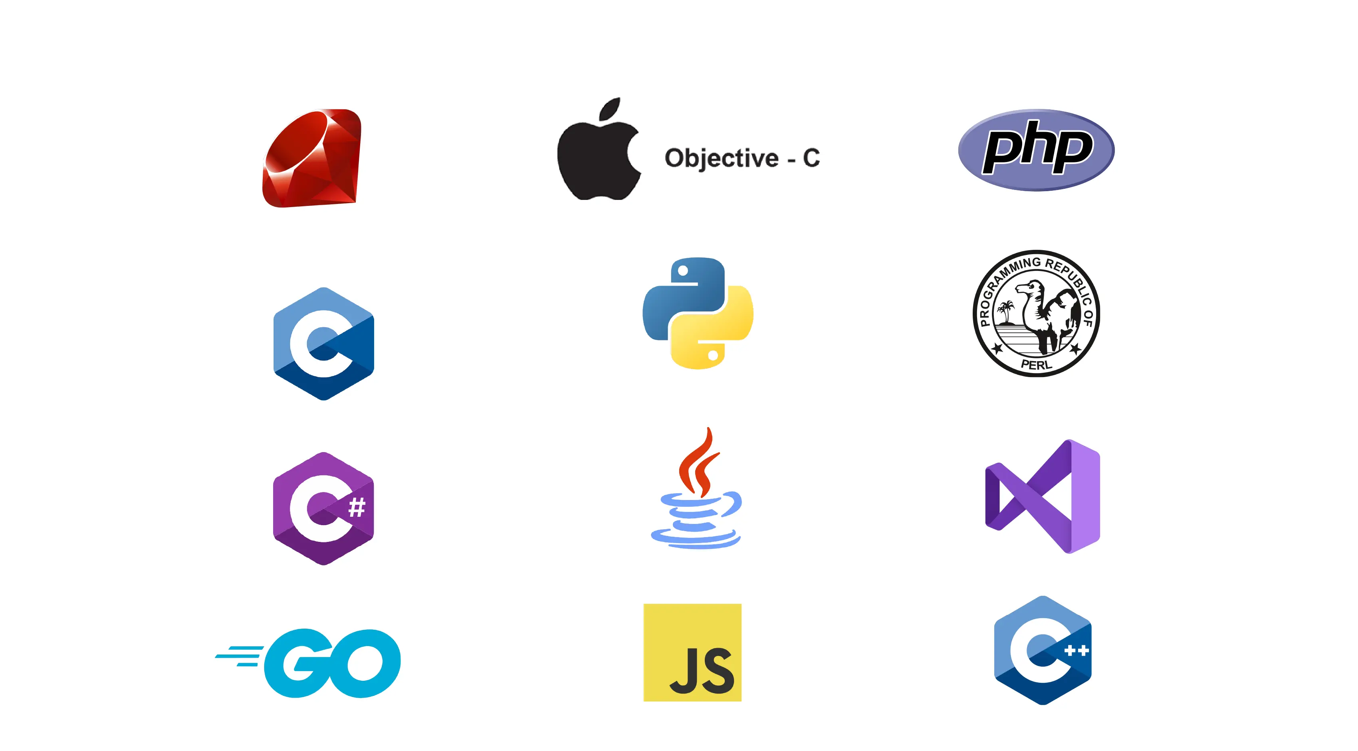


Server or backend

Slide 13
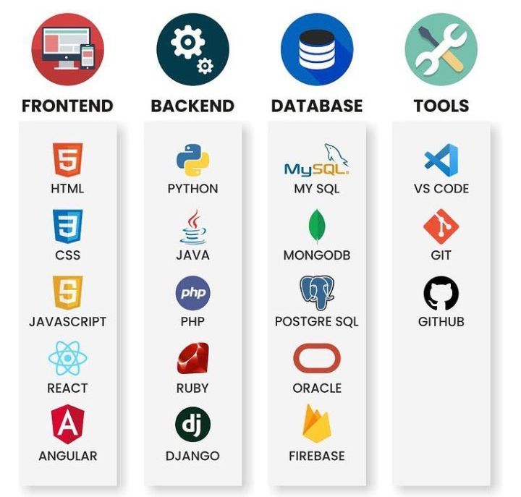
Full stack development

Slide 14
Second Segment - Hands on

Slide 15

Front End

Slide 16
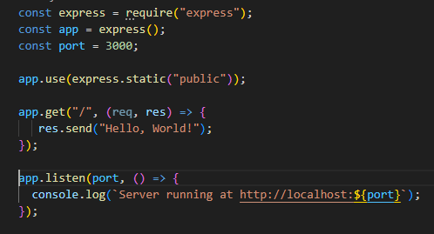
Back-end
Setup Node and Express

